Slide 1
Modelling Signalling
Computational Modelling SSC
Mitchell lab

Slide 2
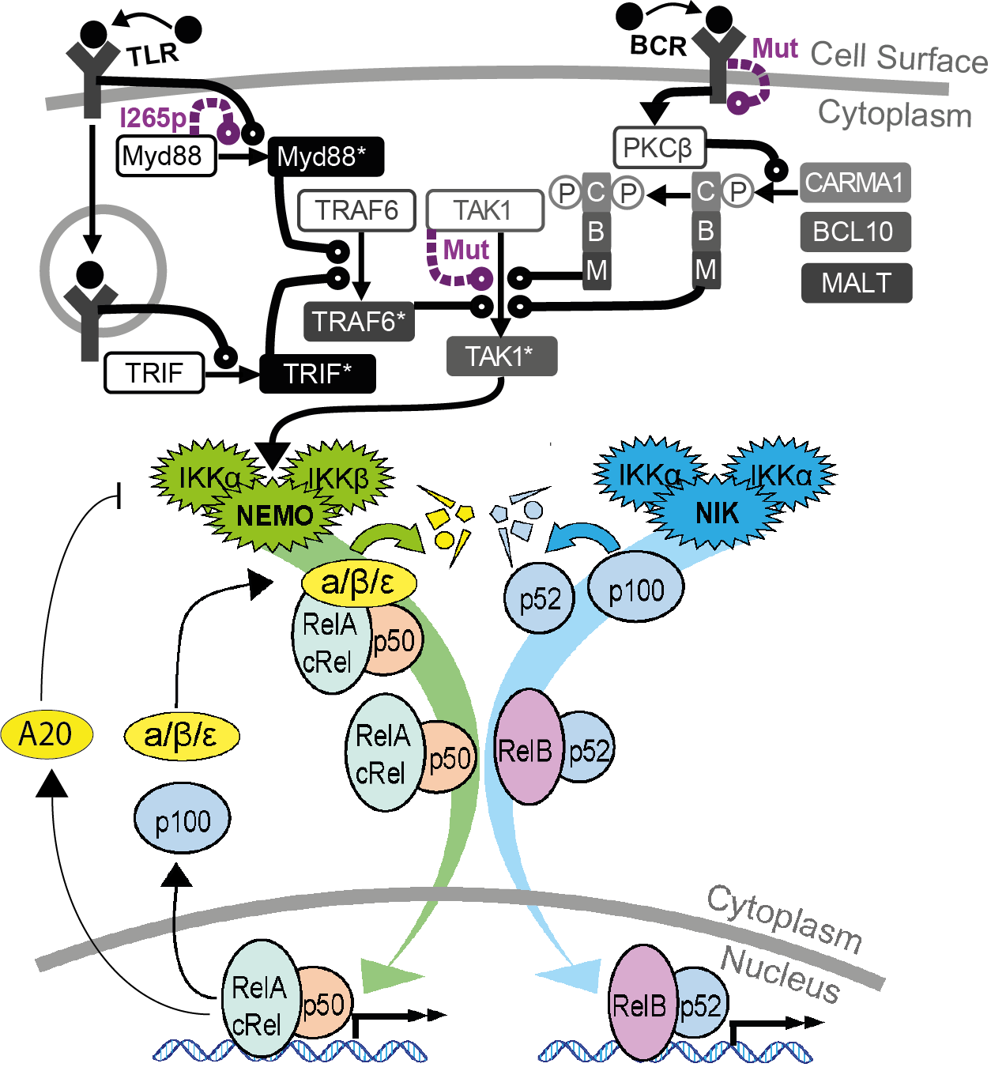
Overview
Previously
We covered population models (SEIR/SIR).
Molecular dynamic models
Today
Signaling pathway models

Slide 3
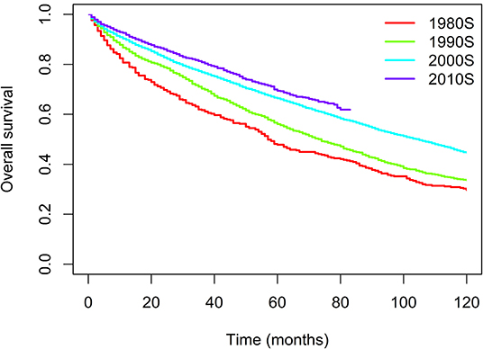
Waldenström Macroglobulinemia
Lymphoma
98% of patients have myd88 L265P mutation
Treated with: BTK inhibitors, proteosome inhibitors, chemotherapy, rituximab.
Treatment progress slowed, new therapies needed.
Yin X, Chen L, Fan F, Yan H, Zhang Y, Huang Z, Sun C, Hu Y. Trends in incidence and mortality of Waldenström macroglobulinemia: a population-based study. Frontiers in Oncology. 2020 Sep 10;10:1712.

Slide 4
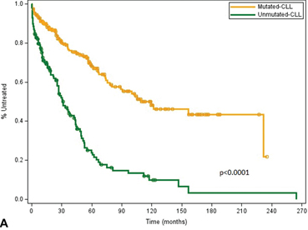
Chronic Lymphocytic Leukaemia (CLL)
Incurable leukaemia
Unmutated CLL has chronic BCR activity, and worse prognosis

Slide 5
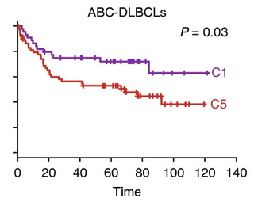
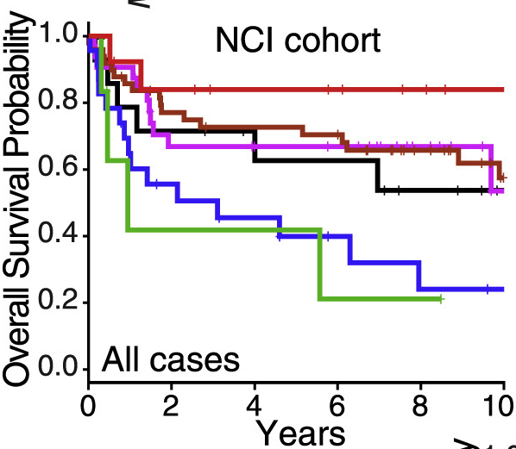
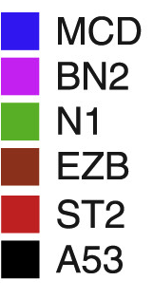
Diffuse Large B-cell Lymphoma
Most common blood cancer
Highly heterogeneous
Recurrent mutations in NF-κB.
Lots of drugs targeting NF- κB.
Patients with NF-κB mutations have worse prognosis

Slide 6
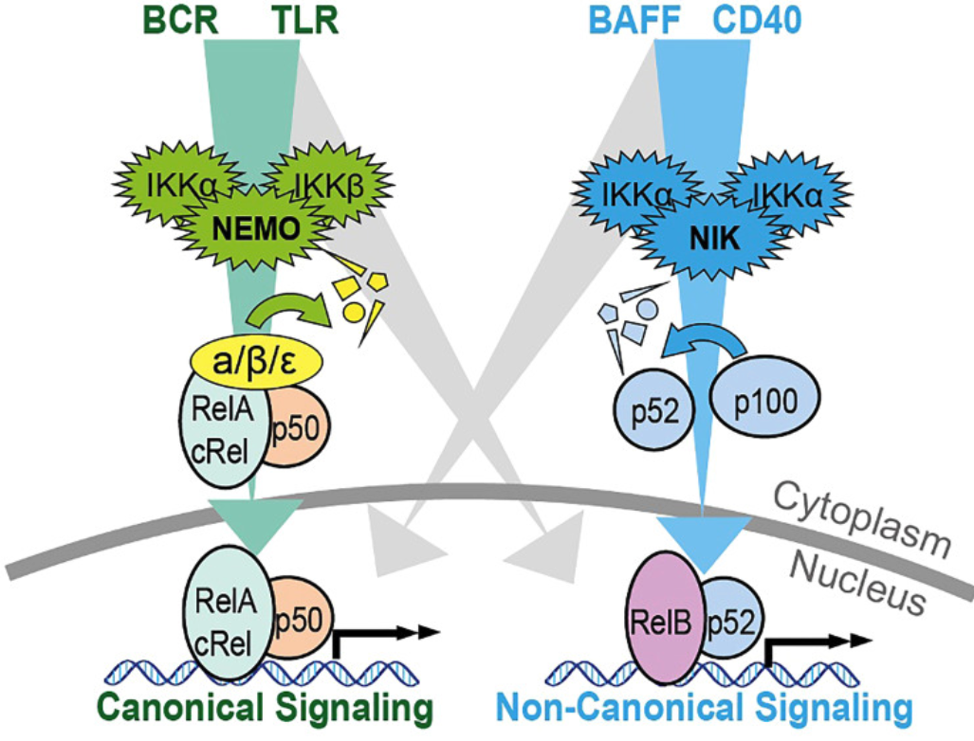
So we need to understand NF-κB
Transcription factor, ubiquitously expressed so hard to drug
Two pathways
Induces cell survival + cell division
Required for immune responses
Very complicated!
O’Donnell A, Pepper C, Mitchell S, Pepper A. NF-kB and the CLL microenvironment. Frontiers in Oncology. 2023 Mar 30;13:1169397.

Slide 7
So we need to understand NF-κB
Transcription factor, ubiquitously expressed so hard to drug
Two pathways
Induces cell survival + cell division
Required for immune responses
Very complicated!
Mitchell S, Tsui R, Tan ZC, Pack A, Hoffmann A. The NF-κB multidimer system model: A knowledge base to explore diverse biological contexts. Science signaling. 2023 Mar 14;16(776):eabo2838.
Notes:
triModelA20Diagram.png

Slide 8
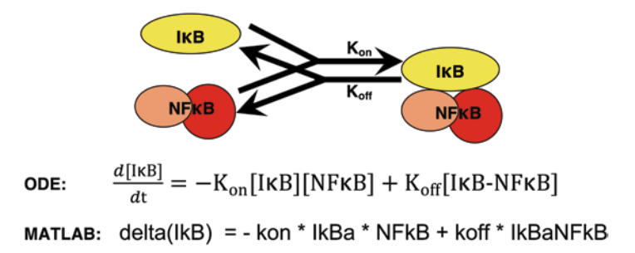
What is Systems Biology?
It starts with a picture
Mitchell S…. Hoffmann A. Methods in molecular biology. 2015

Slide 9
What is Systems Biology?
It starts with a picture
We write some equations
How does IkB change over time
Proportional to the amount of
IkB and NF-kB
Proportional to the amount of the complex IkB:NF-kB
Goes down
Goes Up
Mitchell S…. Hoffmann A. Methods in molecular biology. 2015

Slide 10
What is Systems Biology?
It starts with a picture
We write some equations
We turn the equations into code
Mitchell S…. Hoffmann A. Methods in molecular biology. 2015

Slide 11

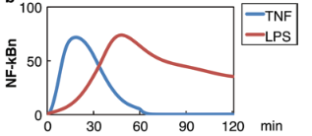
What is Systems Biology?
It starts with a picture
We write some equations
We turn the equations into code
We tell the computer to simulate the system using
Mitchell S…. Hoffmann A. Methods in molecular biology. 2015

Slide 12
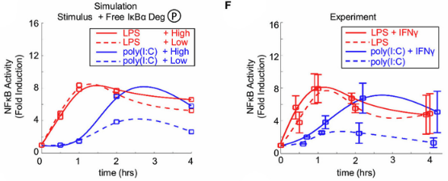
What is Systems Biology?
It starts with a picture
We write some equations
We turn the equations into code
We tell the computer to simulate the system using
Now we compare the simulations to experiments
Mitchell S…. Hoffmann A. Front Immunol. 2019
Notes:
Poly(I:C) = Virus
LPS = Bacteria
IFN gamma amplifies responses to viruses but doesn’t change response to bacteria.

Slide 13
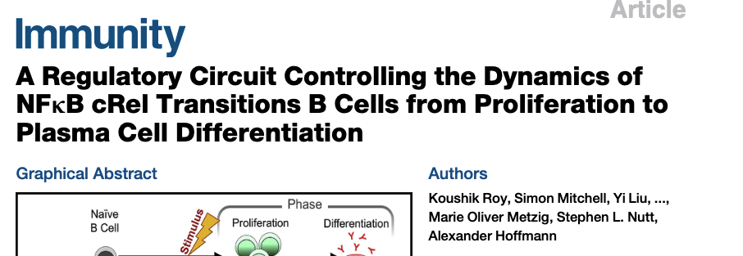
What is Systems Biology?
It starts with a picture
We write some equations
We turn the equations into code
We tell the computer to simulate the system
Now we compare the simulations to experiments
Did we get it right?
We’ve discovered that something was missing from our picture!
No
Yes
We have created an accurate virtual cell!

Slide 14
How can we apply this approach to blood cancer?
It starts with a picture
Built up over many years
Shokhirev…Hoffman, Mol Sys Bio. 2015
Mitchell* Roy*…Hoffmann, PNAS. 2018
Roy*, Mitchell*…Hoffmann, Immunity. 2019
Cloete…Mitchell, NPJ Sys Bio App. 2023
Jayawant…Mitchell, Front Onc. 2023
Mitchell,… Hoffmann. Science Signalling. 2023

Slide 15
3 Inputs:
TLR
BCR
NIK

Slide 16
3 Inputs:
Steady state
Time course
Steady state
Time course
(well 6 really)
TLR
BCR
Steady state
Time course
NIK

Slide 17
3 Inputs:
Steady state
Time course
Steady state
Time course
(well 6 really)
TLR
BCR
uCLL
mCLL
Steady state
Time course
NIK
How do different levels of basal BCR signalling affect response to TLR activation?

Slide 18
Practical Task
Let’s do some modelling
Head to: www.Mitchell.science/ssc and login to the teaching server.
We’ll work through the first half of the sheet together.
The second half asks you to try and find drugs for Waldenstrom's macroglobulinemia

